Slide 1
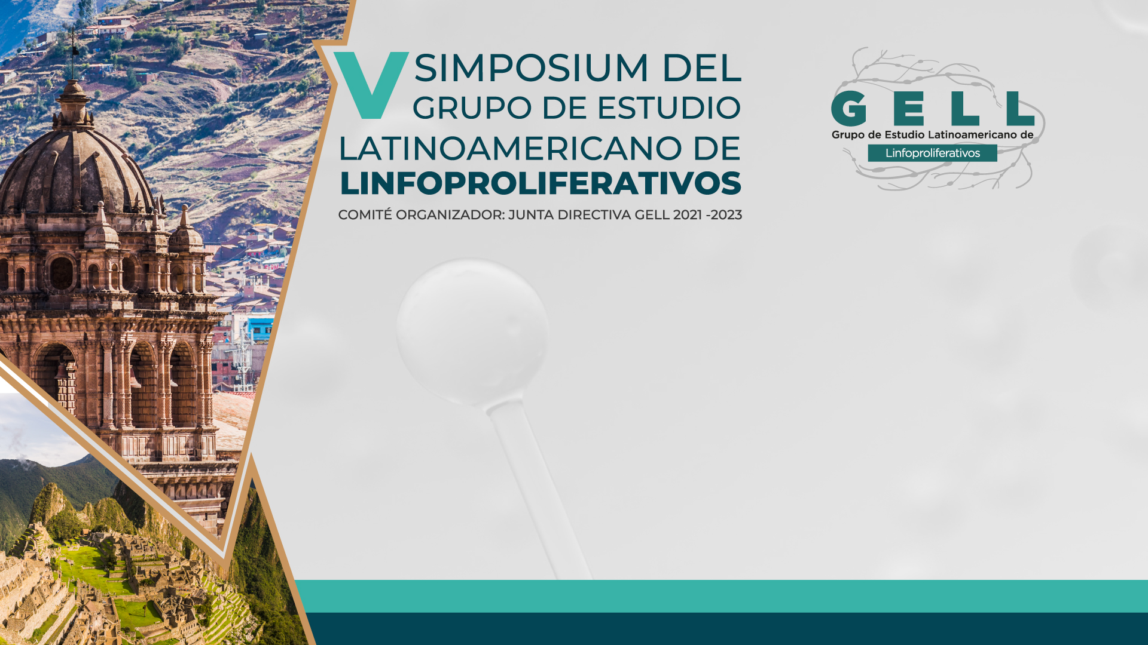
PROGNOSTIC SIGNIFICANCE OF THE NEUTROPHIL/LYMPHOCYTE RATIO IN DIFFUSE LARGE B-CELL LYMPHOMA: A SYSTEMATIC REVIEW AND META-ANALYSIS
Rafael Pichardo-Rodriguez, MD
Médico Hematólogo
Instituto de Investigaciones en Ciencias Biomédicas (INICIB). Universidad Ricardo Palma

Slide 2

Agenda
Background
Objetive
Methods
Results
Conclusión

Slide 3
BACKGROUND
The neutrophil-lymphocyte ratio (NLR) has stunned up as an easy to use prognostic biomarker in different cancers.
Although the exact mechanism remains to be elucidated, reduced infiltration of intratumoral lymphocytes along with the development of neutrophil extracellular traps (i.e., NETosis) has been postulated as endogenous mechanisms for tissue damage and inflammation.
We previously reported a NLR ≥4 as independently associated to inferior complete response rates to chemoimmunotherapy and worse survival in Latin American (LATAM) patients with diffuse large B-cell lymphoma (DLBCL; Beltran, Clin Lymphoma Myeloma Leuk, 2020).

Slide 4
OBJETIVE
Here we present a systematic review and meta-analysis on the prognostic value of the NLR in DLBCL.

Slide 5
METHODS
A systematic search was conducted using PUBMED, EMBASE and SCOPUS databases up to the most recent date (October 2022). Prospective and retrospective cohorts were reviewed using the diagnosis of DLBCL according to the WHO criteria.
The NLR was defined as the ratio between absolute neutrophil and lymphocyte counts in peripheral blood prior to initiating therapy. Two independent reviewers selected the studies and subsequently extracted the data.
Clinical variables included gender, age, tumor stage, IPI, presence of B symptoms, serum LDH level, extranodal location, ECOG performance status, treatment regimen, NLR value, Hazard Ratio with its respective 95% confidence interval (CI).
Once the quality of the extracted data was verified, a quantitative synthesis of the information was conducted through a meta-analysis-based approach.

Slide 6
METHODS
Additionally, a sensitivity analysis was performed using the leave-one-out method and a NLR cut-off of >4.
A meta-regression model was applied to assess the influence of a sample size <200 (based on previous reviews) on the heterogeneity of the results.
Publication bias was analyzed using the funnel plot, as well as Egger's test. Additionally, a trim and fill analysis was performed to assess the impact of unpublished studies on the overall estimate.

Slide 7
METHODS
Primary endpoints were overall survival (OS) and progression-free survival (PFS) rates.
Association was reported by Hazard Ratio (HR).
Risk of bias was assessed using the Newcastle-Ottawa Scale adapted by Hassan-Murad et al.
Data were analyzed using the R program version 4.2.3.

Slide 8
RESULTS
Fifteen studies were identified and 4,149 patients were included.
Only 3 studies were from Latin America.
The median NLR was 4.1 (range 1.5 to 5.54).

Slide 9
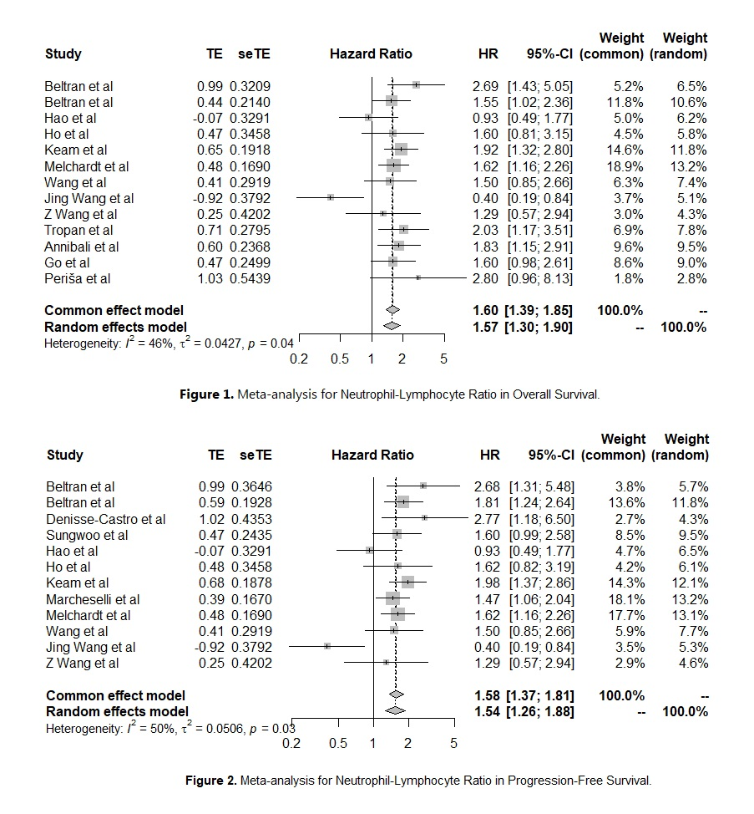
RESULTS

Slide 10
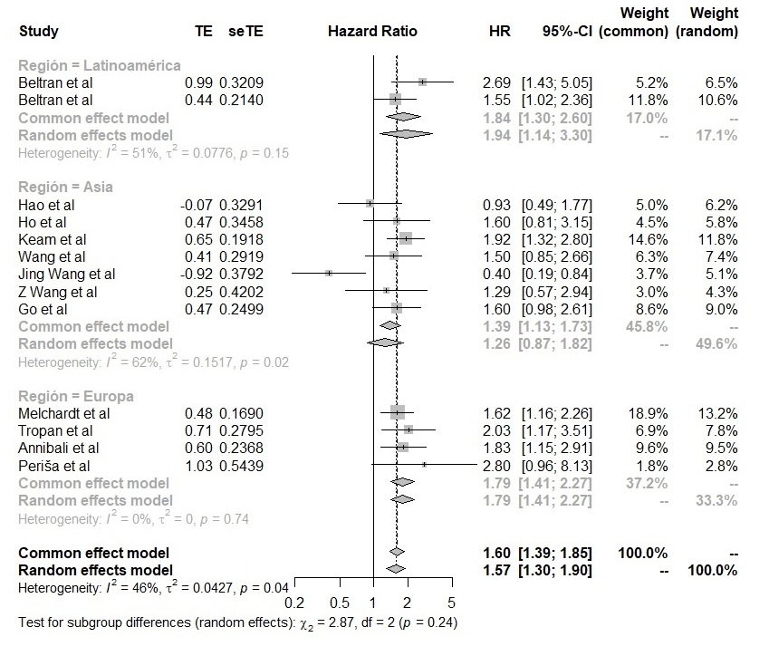
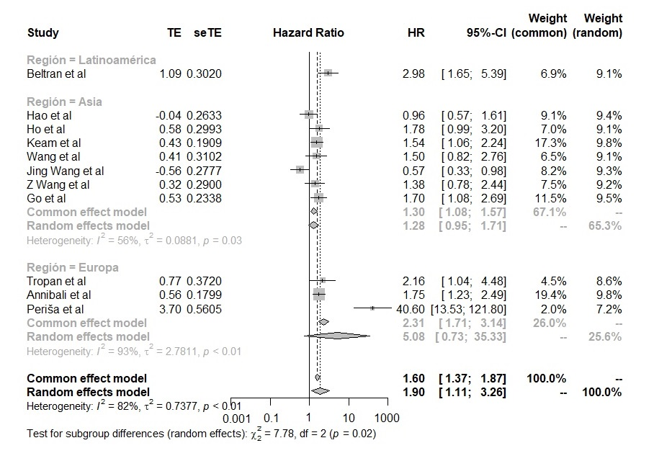
Figure 3. Subgroup analysis by region for OS and PFS.

Slide 11
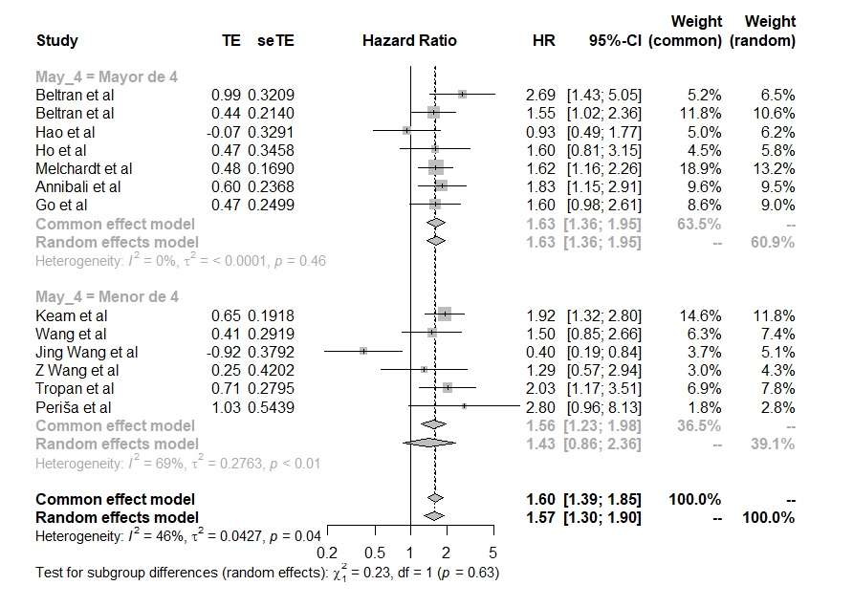
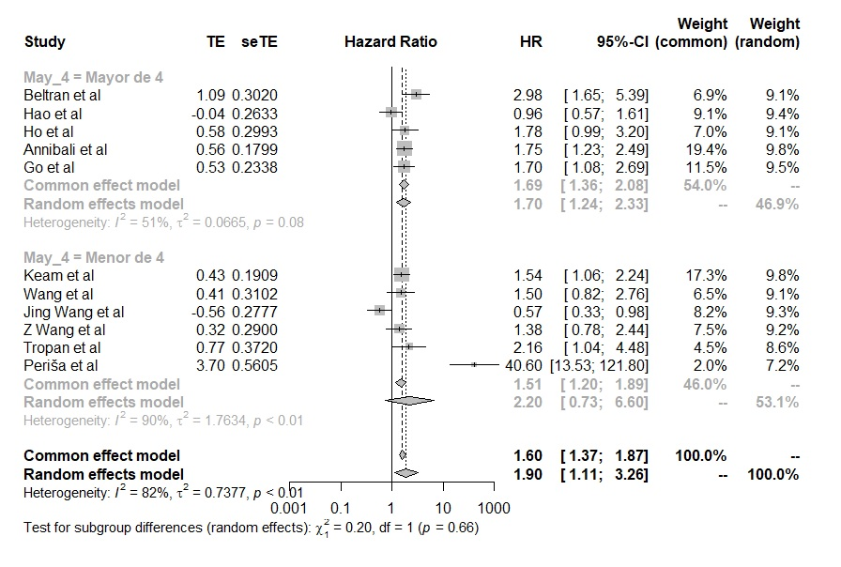
RESULTS
Figure 4. Subgroup analysis by NLR>4 for OS and PFS.

Slide 12
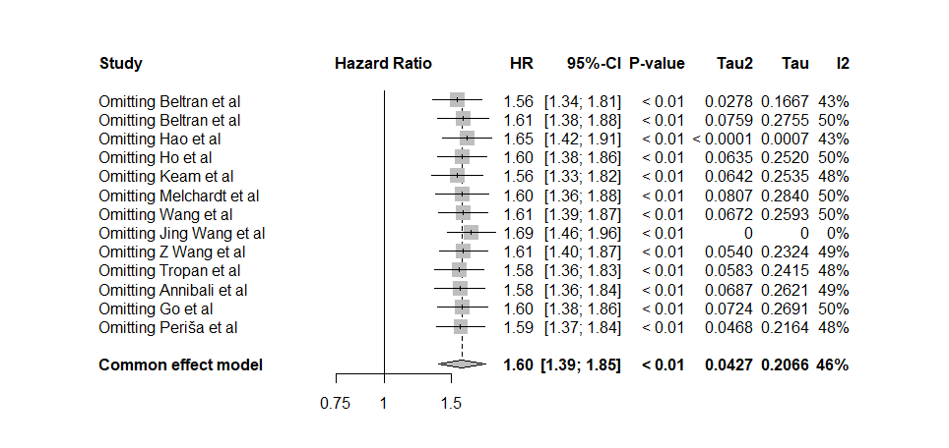
RESULTS
Figura 5. Analisis de sensibilidad para OS.

Slide 13
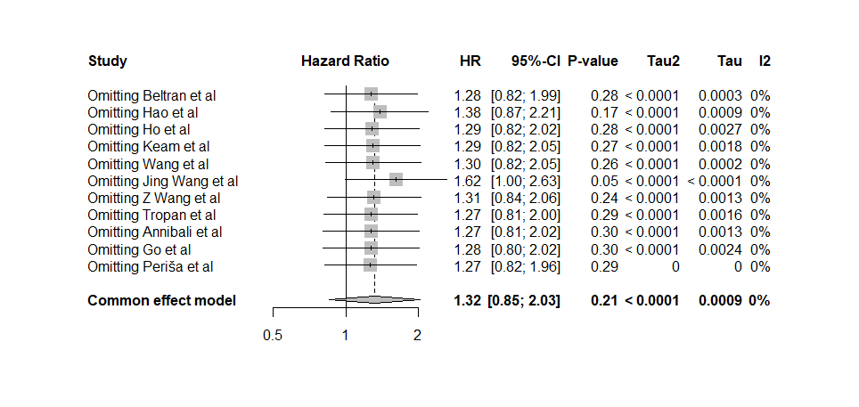
RESULTS
Figura 6. Analisis de sensibilidad para PFS.

Slide 14
RESULTS

Slide 15
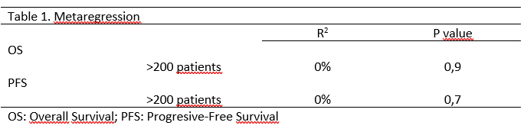
RESULTS

Slide 16
DISCUSSION
Our study found the NLT as a relevant prognostic factor for OS in DLBCL patients.
The main limitation was the inconsistency of the cut-off values for the NLR in the different studies included, suggesting the need to standardize this cut-off for future research studies.
However, a cut-off point >4 could be a promising clinical biomarker for this patient population.

Slide 17

GRACIAS

